Slide 1
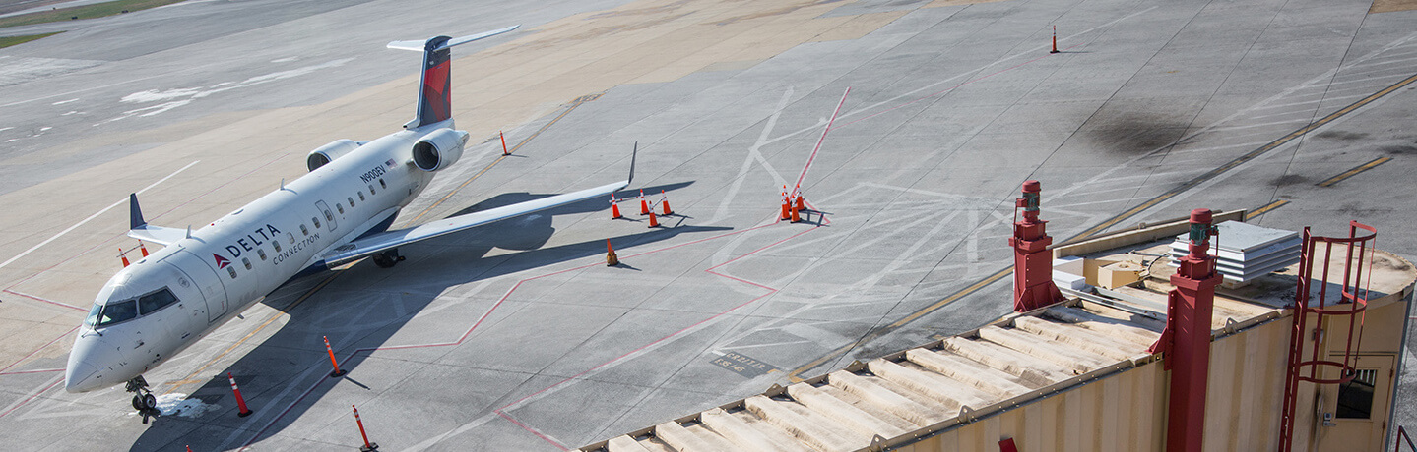
Project #2: Visualize US Airport/Airline Statistics
Week 18
The Data Bootcamp |
Bharat
Gokul
Ritesh
2019

Slide 2
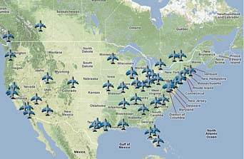
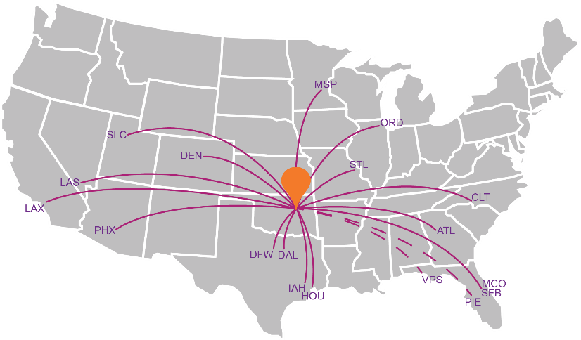

Where are the: - airports, What are the: - airline route maps, Which: - airline has flown max #of flights over time

Slide 3
Airport, Airlines Data
Main sources:
“Airport details CSV/JSON” Dataset about airports (origin, destination) from http://datasets.flowingdata.com/tuts/maparcs/flights.csv
https://gist.github.com/tdreyno/4278655#file-airports-json
“Airlines Json” Dataset about flights (including number of flights over time) from https://think.cs.vt.edu/corgis/json/airlines/airlines.html

Slide 4
Tasks
Notes:
It’s important to keep in mind why you joined this class. Let’s talk about your goals.

Slide 5
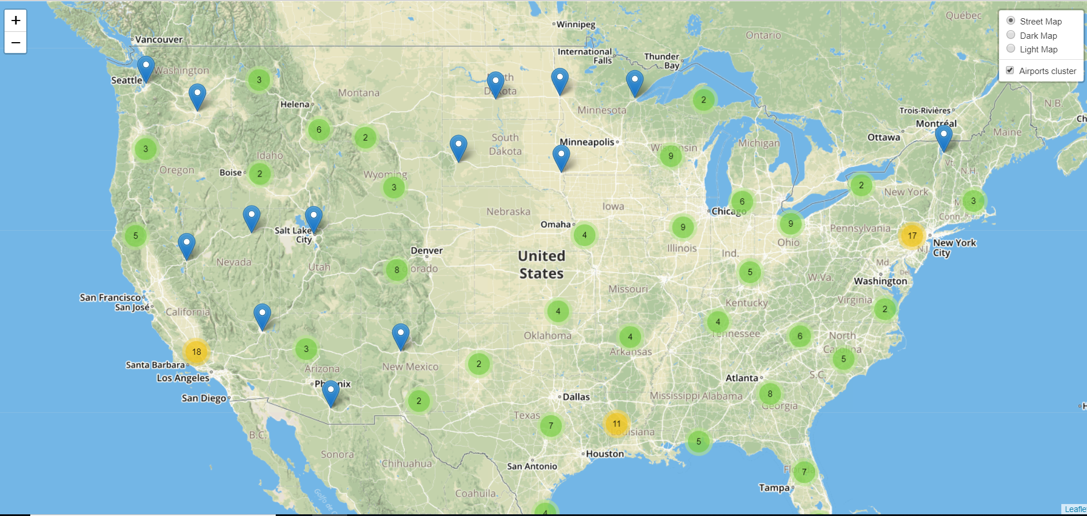
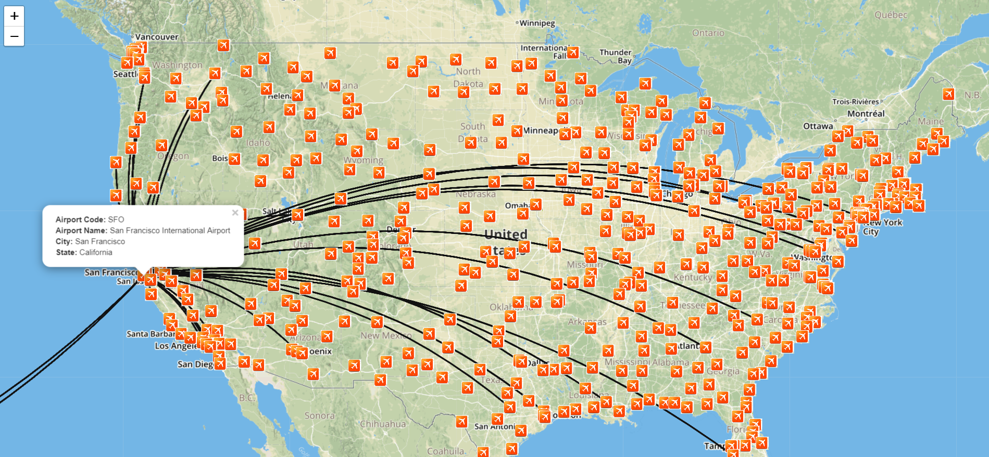
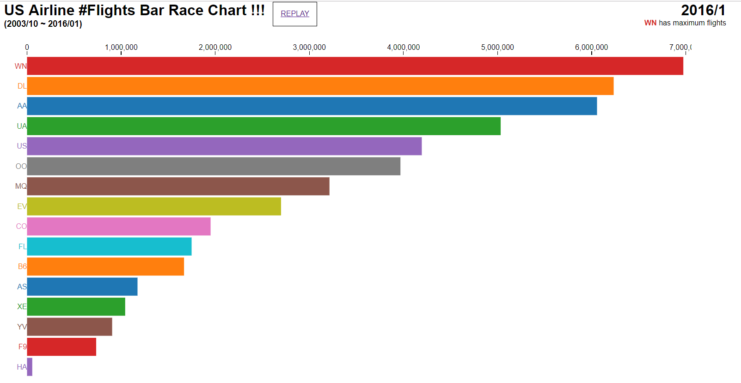
Work Flow
OUTPUT
4
3
2
FLASK
Logic – HTML/JS
1
ETL Process
Read – Clean – Save
Local
Data
MySql

Slide 6
Data Munging (Pandas)
Read Json, CSV via ipynb.
Cleaned, loaded data set to MySQL
Read, aggregate save as local

Slide 7
Flask (app.py)
Create Flask routes from database tables, data – CSV, JSON sources:
@app.route(‘/’) → Main Index File
@app.route("/Airportlogicindex") → Airport locations
@app.route("/curvedpathindex") → Route Maps
@app.route("/barracechartindex") → Bar Race Chart

Slide 8
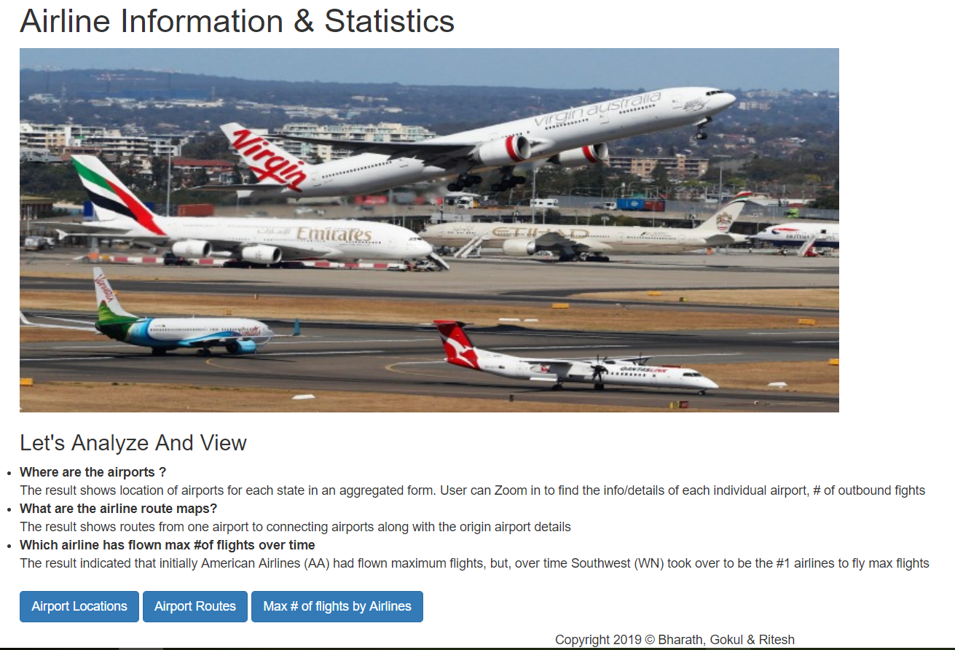
@app.route(‘/’) → Main Index File

Slide 9
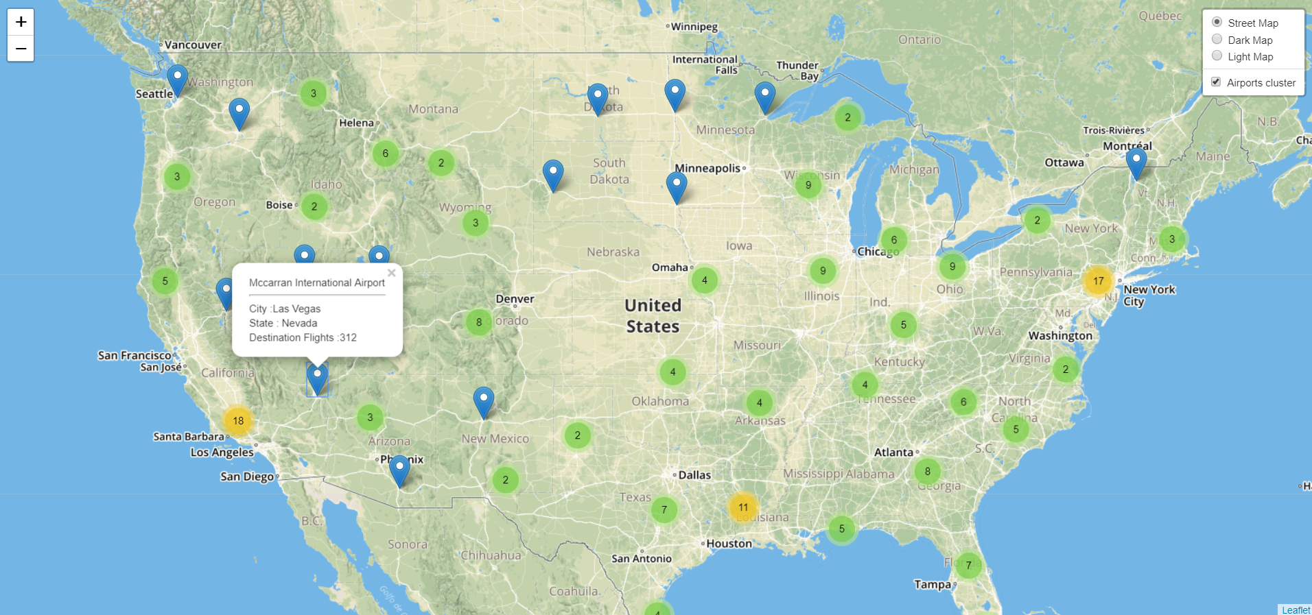
@app.route("/Airportlogicindex")
Logic, Functions, Visualizations
Created “Airportlogic” JavaScript
US Airports, #of Outbound Flights

Slide 10
@app.route("/curvedpathindex")
Logic, Functions, Visualizations
Created “curvedpathlogic” JavaScript file.
US Airport to Airport Routes

Slide 11
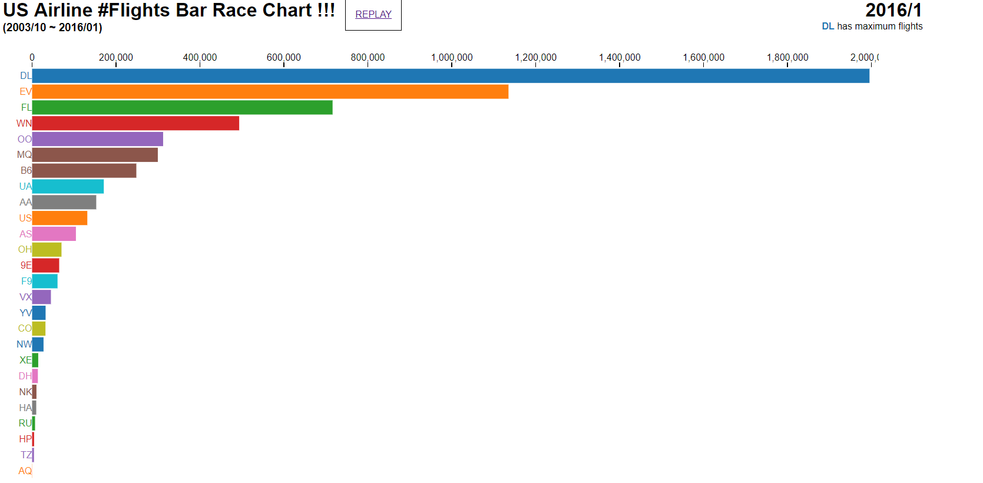
@app.route("/barracechartindex")
Logic, Functions, Visualizations
Created “barracechartlogic” JavaScript file.
US Airline #of Flights Bar Race Chart over time

Slide 12
Analysis :
Airport visualization:
The result shows location of airports for each state in an aggregated form. User can Zoom in to find the info/details of each individual airport, # of outbound fights.
Airport To Airport Route:
The result shows routes from one airport to connecting airports along with the origin airport details.
Airlines Bar Race Chart:
The result indicated that Delta Airlines (DL) had flown maximum flights.

Slide 13

App Deployed on Heroku
https://airports-flights-analysis.herokuapp.com/

Slide 14
Questions / Discussion
Notes:
It’s important to keep in mind why you joined this class. Let’s talk about your goals.

